Slide 1

Green Flag Assessment 2024-2025

Slide 2
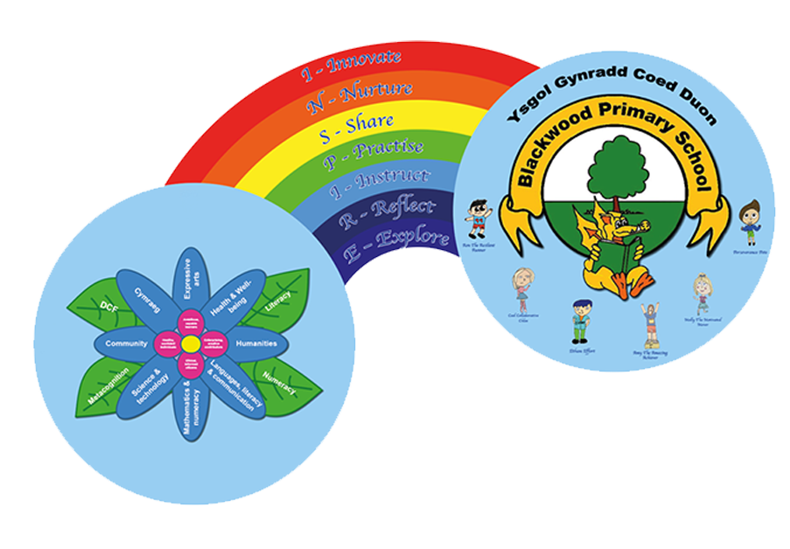
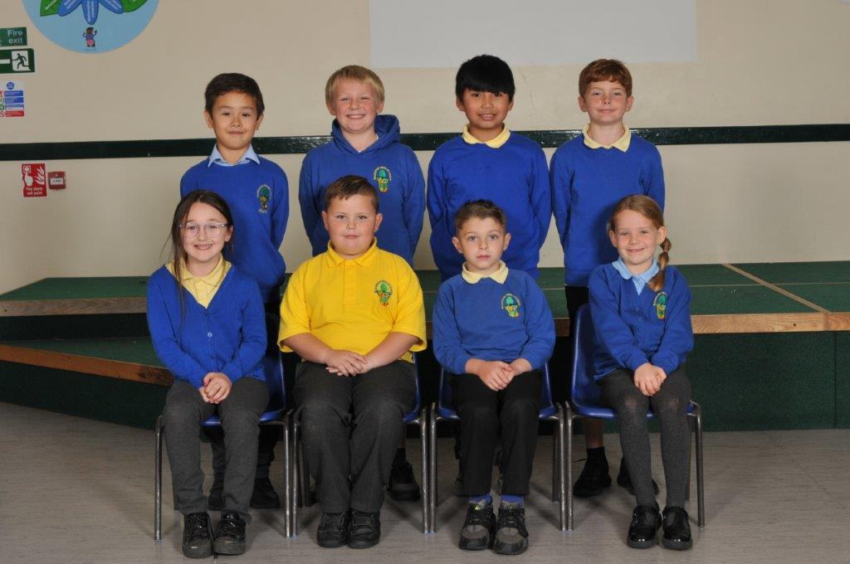
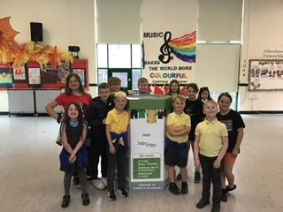
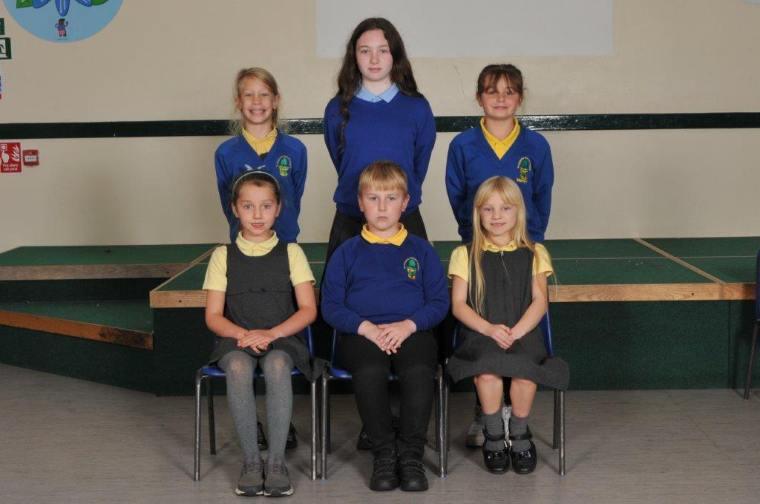
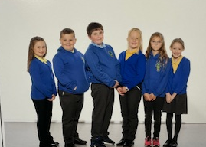
Our Eco Committee
2021-2022
2022-2023
2023-2024
2024-2025

Slide 3
Why we wanted to be an Eco Member
“I want to be able to make a difference and keep our environment clean.”
“I want to inspire people to look after our planet.”
“I like learning new skills and working with my friends.”
“I get to work with different people and doing things that are good for our school.”
“I always try to make sure I make the right choice to help our planet.”
“I love working as a team to help other people. I also love nature and want to keep it nice and tidy.”

Slide 4
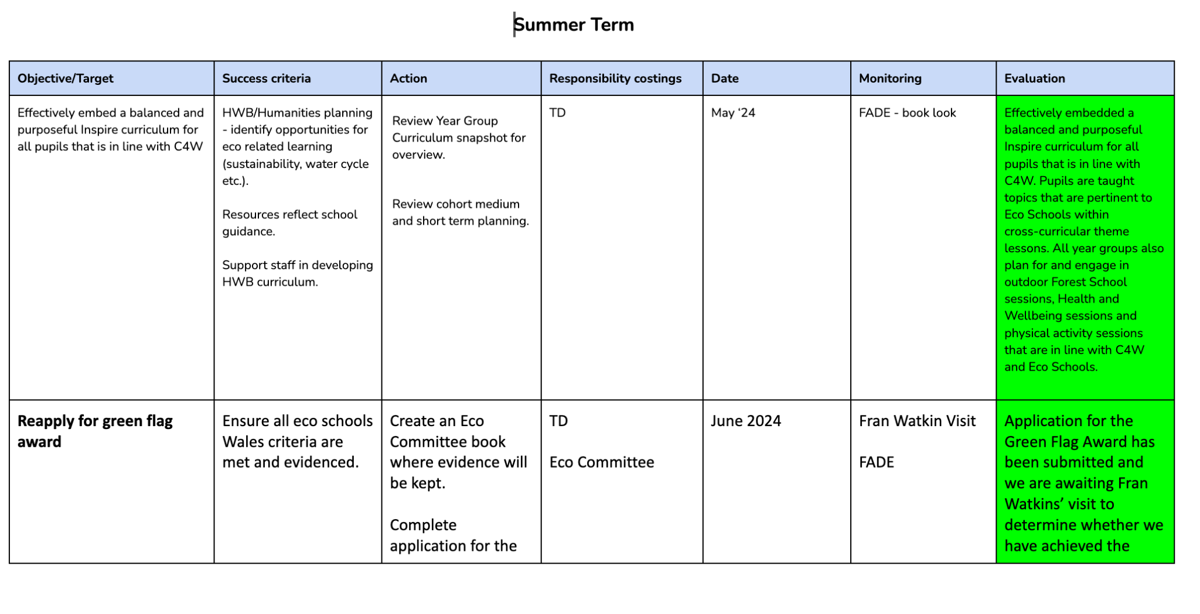

Our Action Plan
Our Action Plan:
We complete an annual environmental review to help us come up with our action plan as a team. Mr Davies then creates a document so Mrs Davies knows what we have planned.
When the term comes to an end we meet with Mr Davies to evaluate whether we have achieved our targets.
We use this evaluation to make any changes to our future targets and to come up with ideas of what we need to do next.

Slide 5

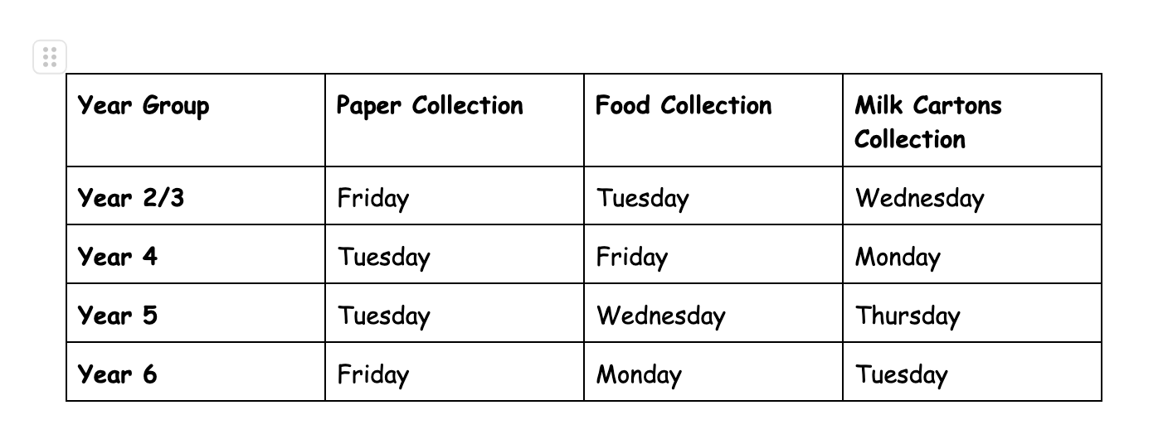


What We Do
Our Roles and Responsibilities:
We recycle waste paper and milk cartons in the school:
We have a rota for the collection of paper waste from each class every Friday.
We are waiting for our new bins to create a rota for the collection of milk cartons from Foundation Phase and food waste class every day.
We have completed an up to date environmental survey to identify areas we can improve in order to achieve the Green Flag Award.
How we are elected:
We share our ideas and the reasons why we want to be a part of the team in our year groups.
We are voted anonymously by our friends and the votes are counted by our teachers.
Our Meetings:
We meet at least once per half term to make sure we are aware of what we have planned.
Mr Davies takes meeting notes and keeps a record of them on our school drive.
We decide what we are going to share in our Eco Committee assemblies.
We talk about what we have done throughout the term so we can add it to the Senedd Newsletter.

Slide 6
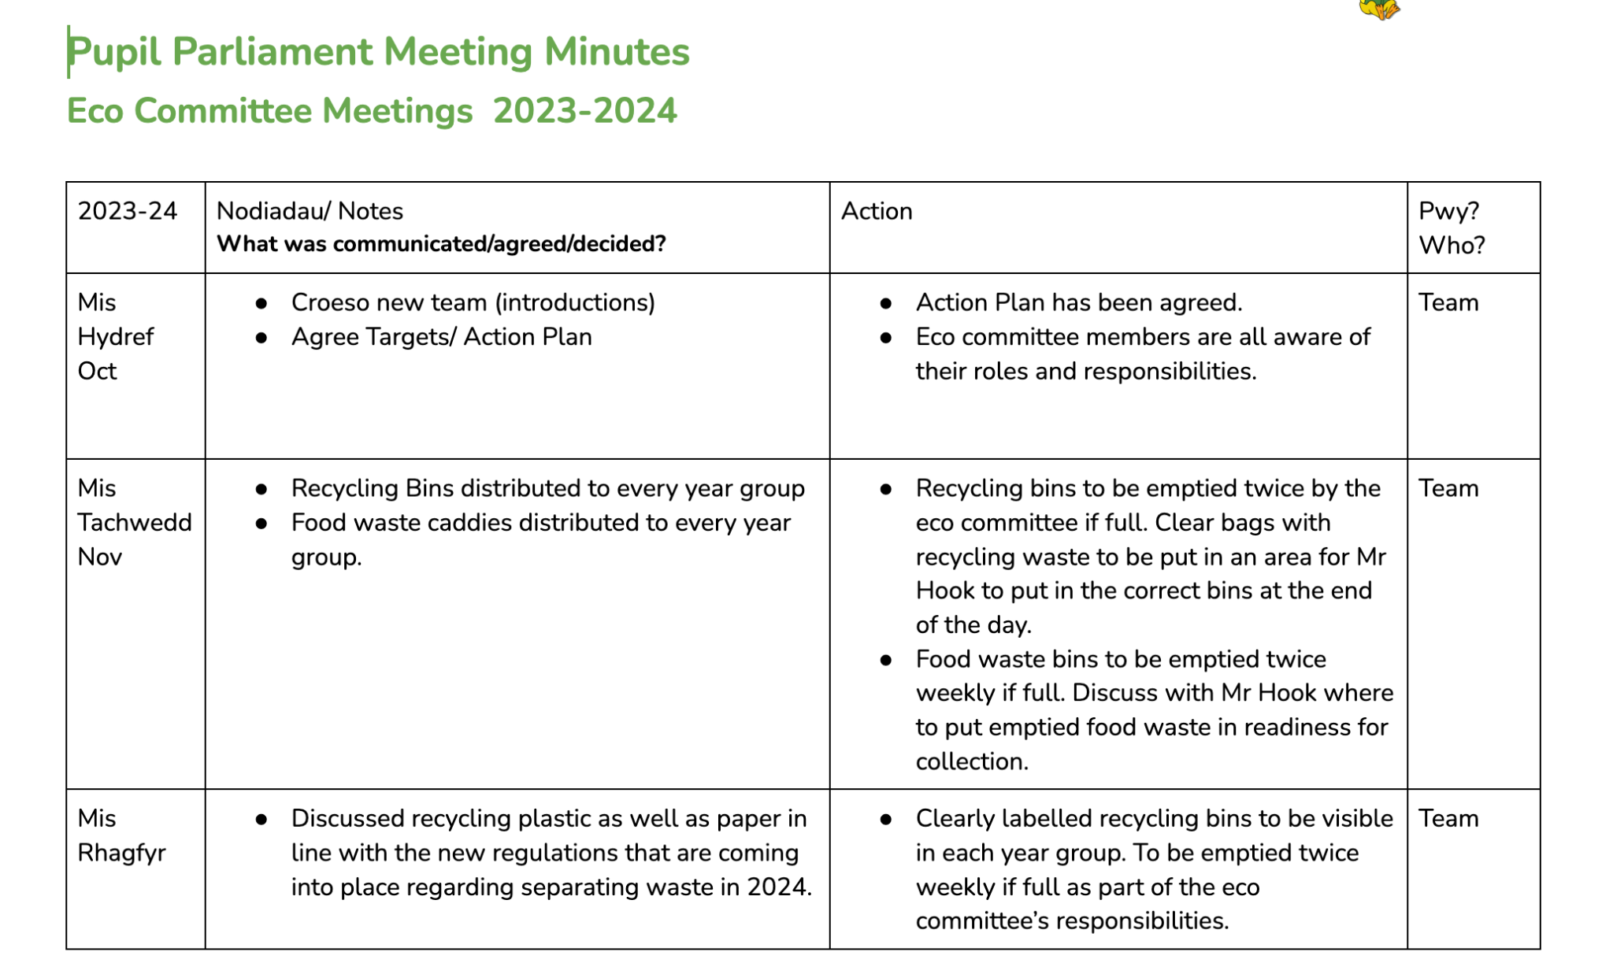
An example of meeting notes

Slide 7
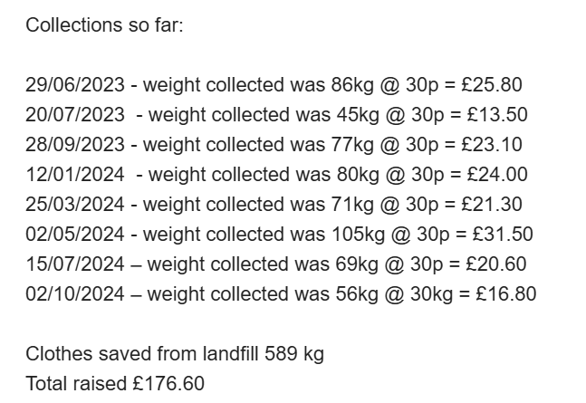

Recycling unwanted clothes
Unwanted clothing items:
We have recently received a Dragon Bags Drop Box. This allows us to donate unwanted items of clothing to charity and receive a donation to help us improve our school environment.
Since we received the Dragon Bags Drop Box, we have raised nearly £200. This money helps us purchase new resources all across our school, to ensure we continue to develop our learning in a variety of ways.

Slide 8
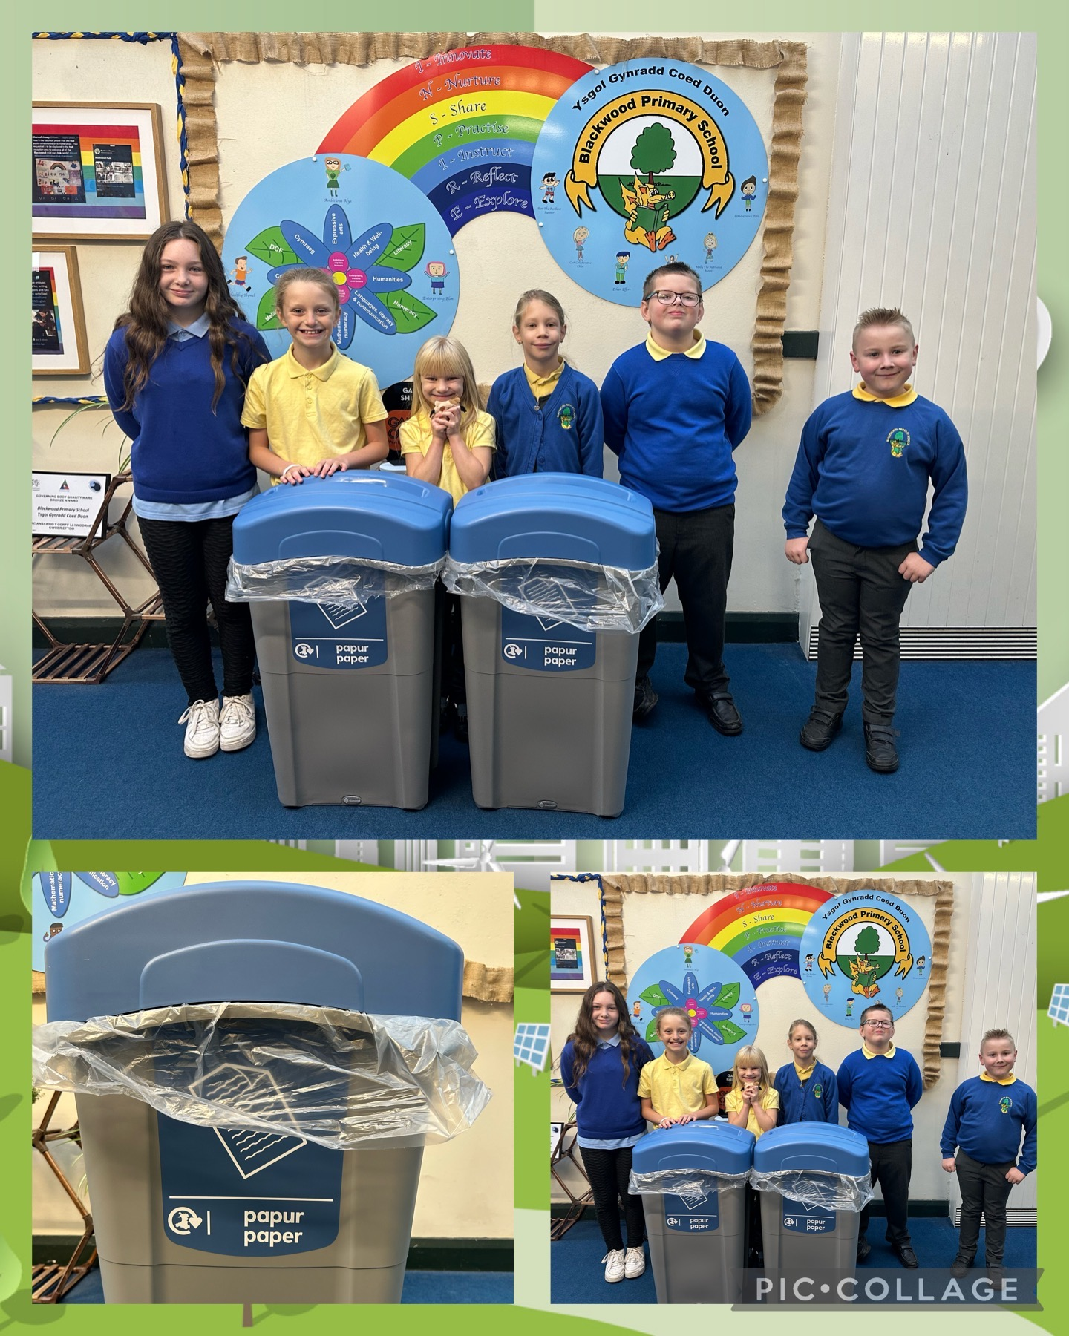

Emptying the bins
Our bin checks:
We complete weekly bin checks to help make sure all the waste is correctly separated so Mr Hook can put it in the correct bin.
We have recently received some new food waste bins to replace old damaged/missing bins.
We are waiting for new plastic and tin waste bins to make sure that we continue separating our waste correctly, following the new rules set by the government.

Slide 9


Our Blackwood Primary School Water Bottles
IMAGE HERE
Water Bottles:
In the summer, Mr Davies also took over the Healthy Crew in Blackwood Primary School.
The Healthy Crew had a huge focus on drinking water in school, rather than drinking squash or any other sugary drinks.
We decided that the best way to promote this was to create our own reusable school water bottles. These are available to all pupils in the school and since launching them, we have raised £100.

Slide 10
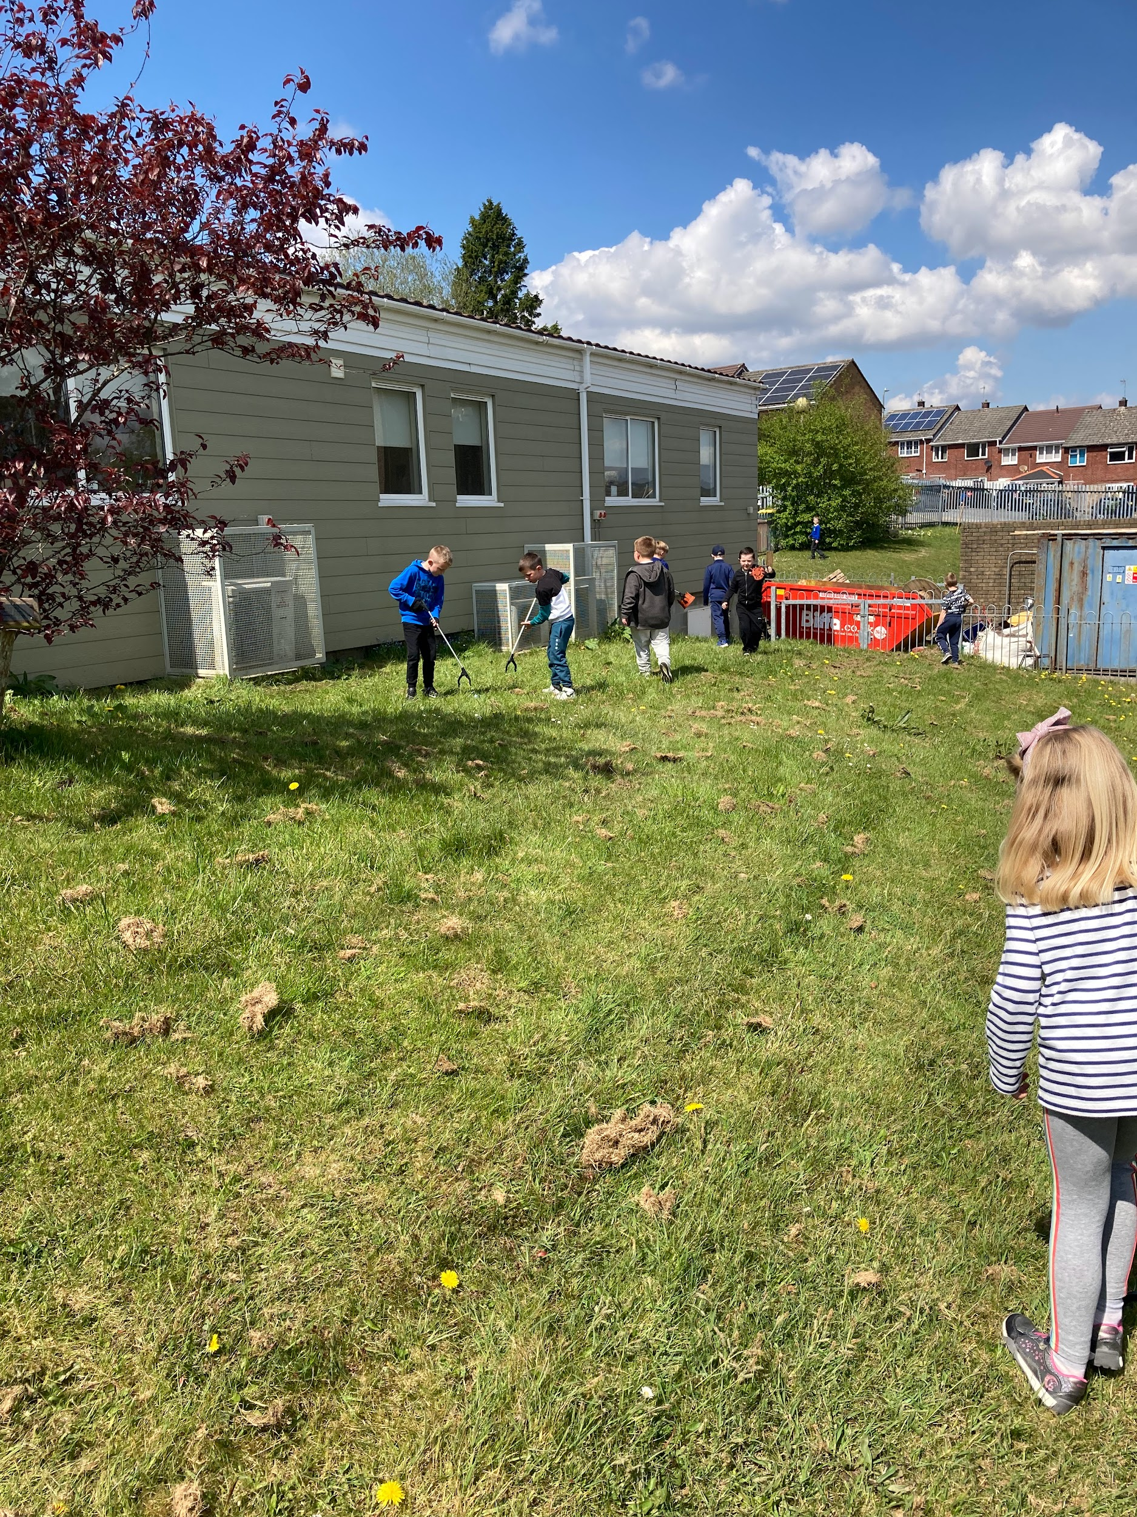

Keeping our Environment Clean
Litter Picking:
We have a number of litter pickers in school so that we can make sure we keep our school grounds clean.
Mrs Hiscott takes pupils from throughout the school on a litter pick as part of her wellbeing sessions. We believe that by being outside and taking care of our school grounds has a huge positive impact on our mental health.
We make sure to take part in any litter picking schemes that are available to us in our local area and look forward to being part of the next litter picking event.

Slide 11
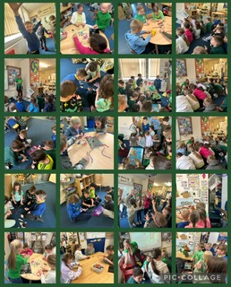
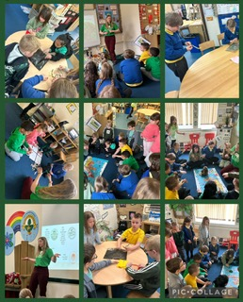
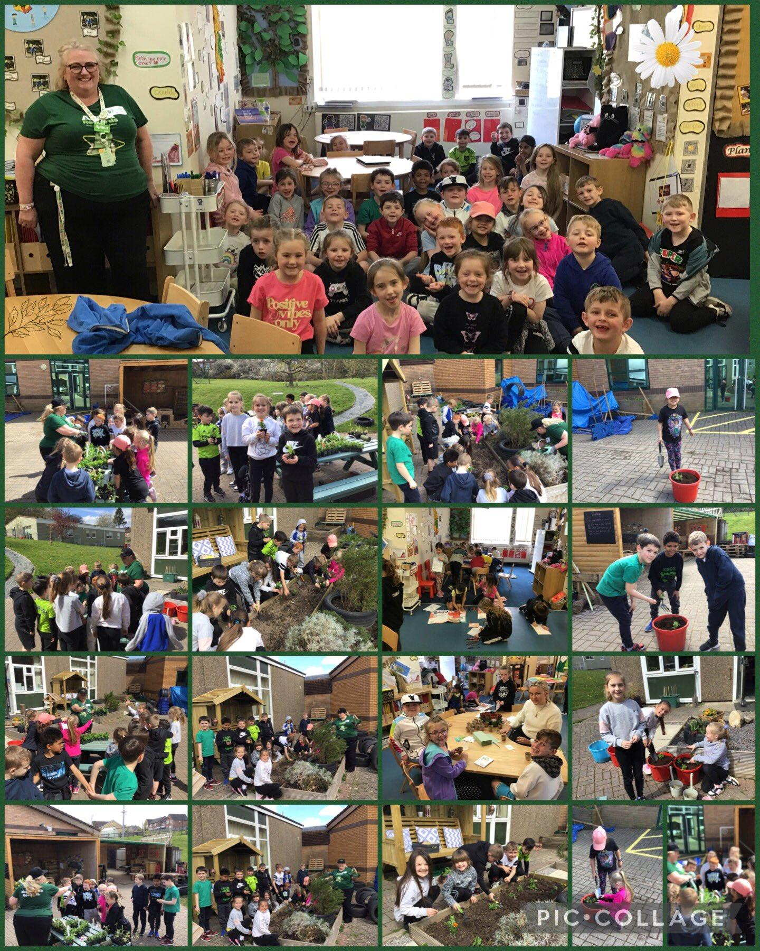
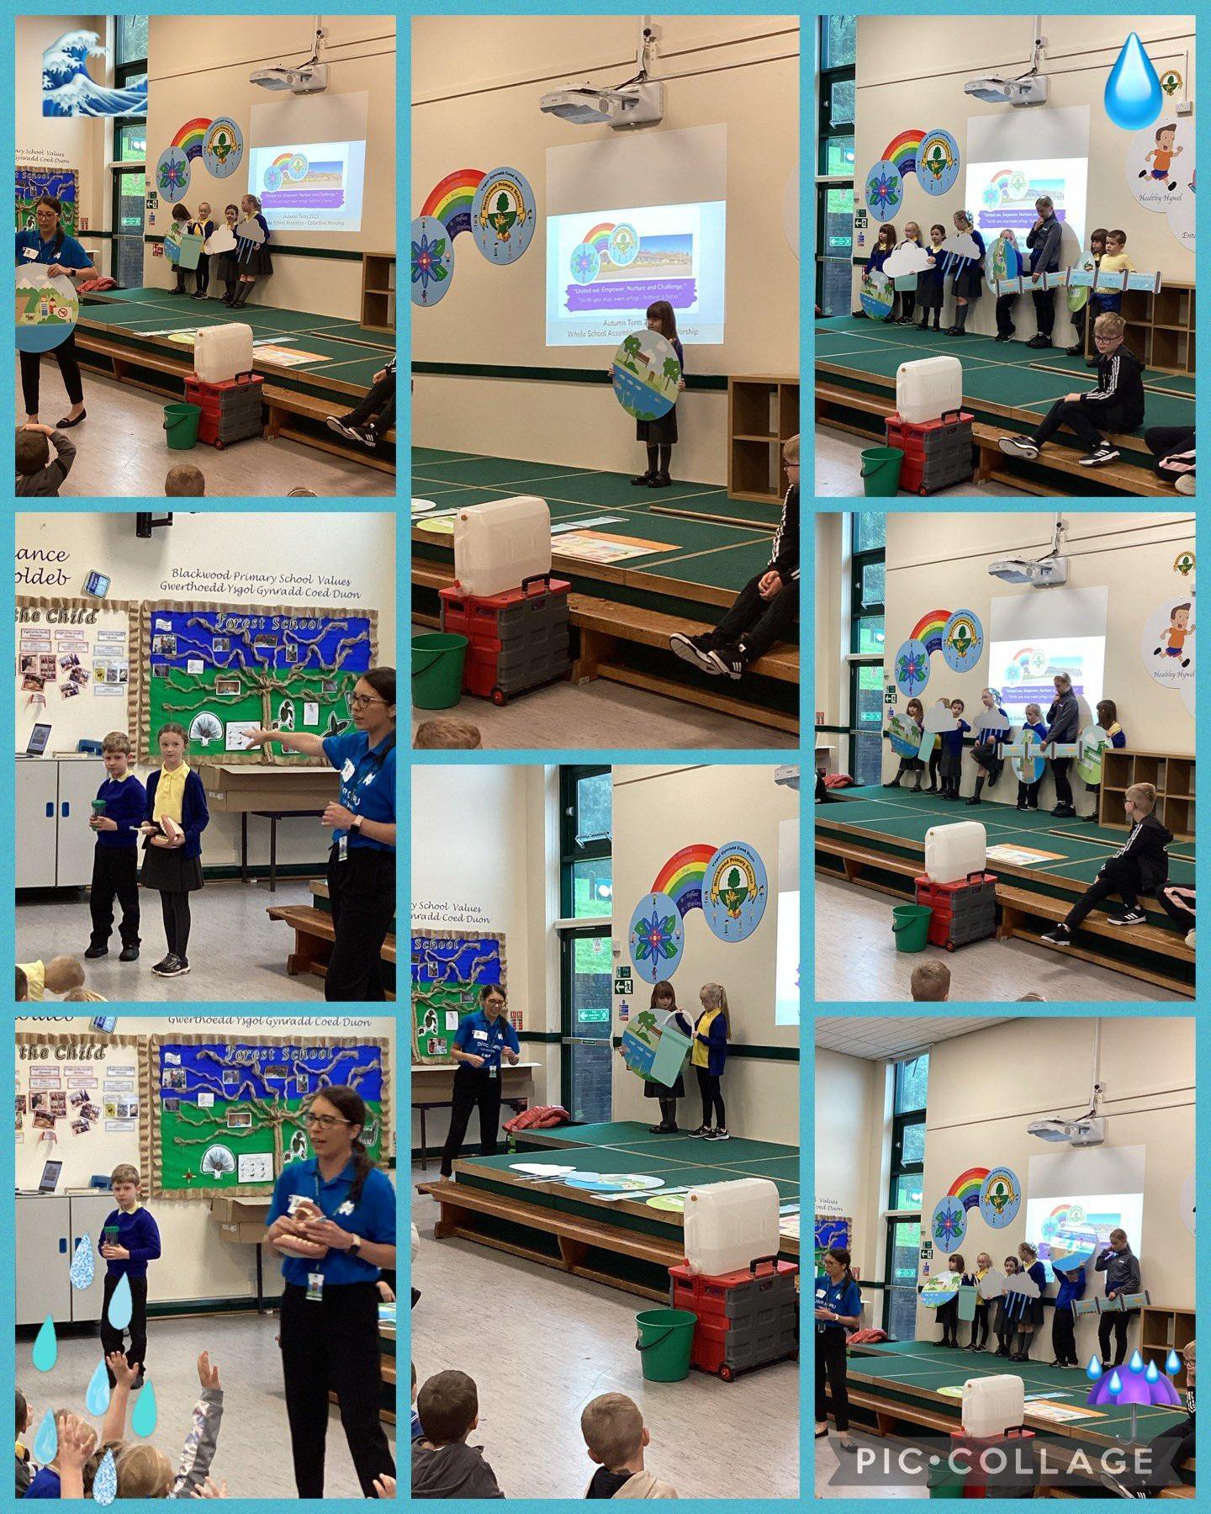
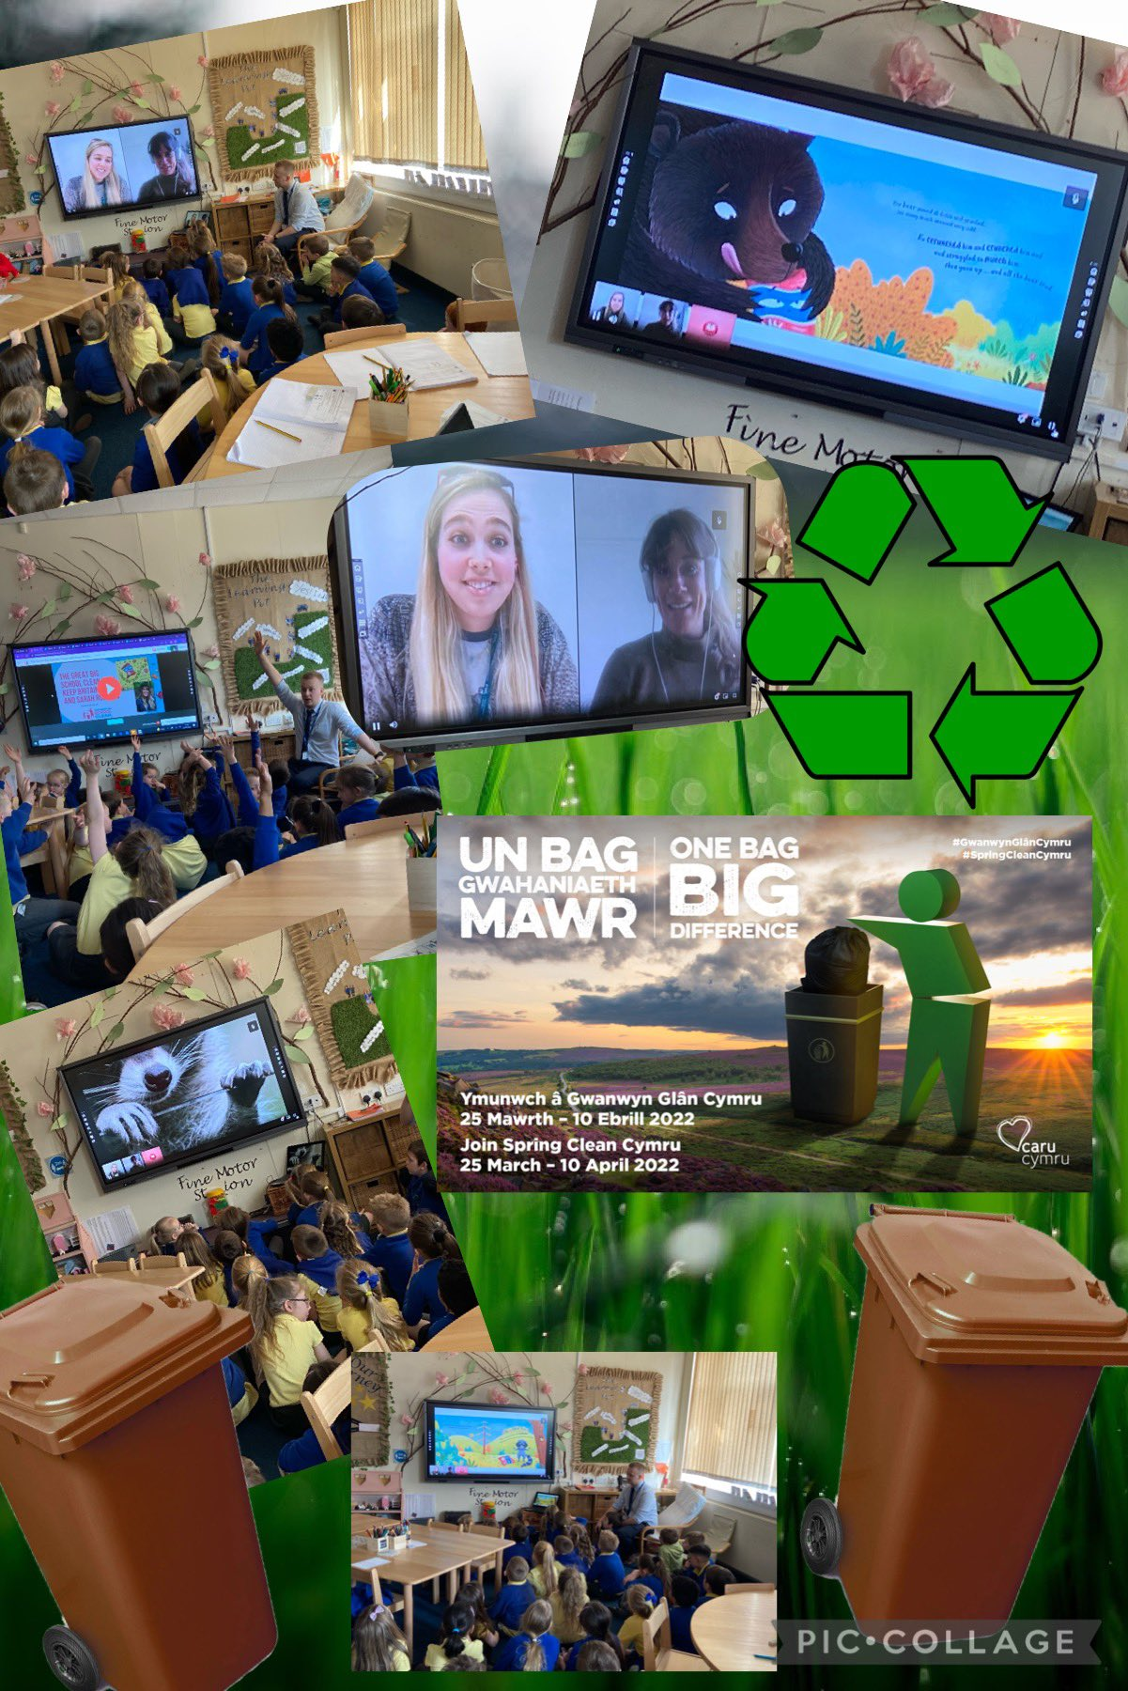
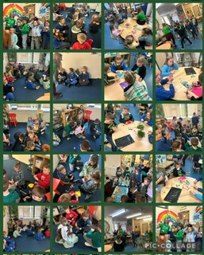
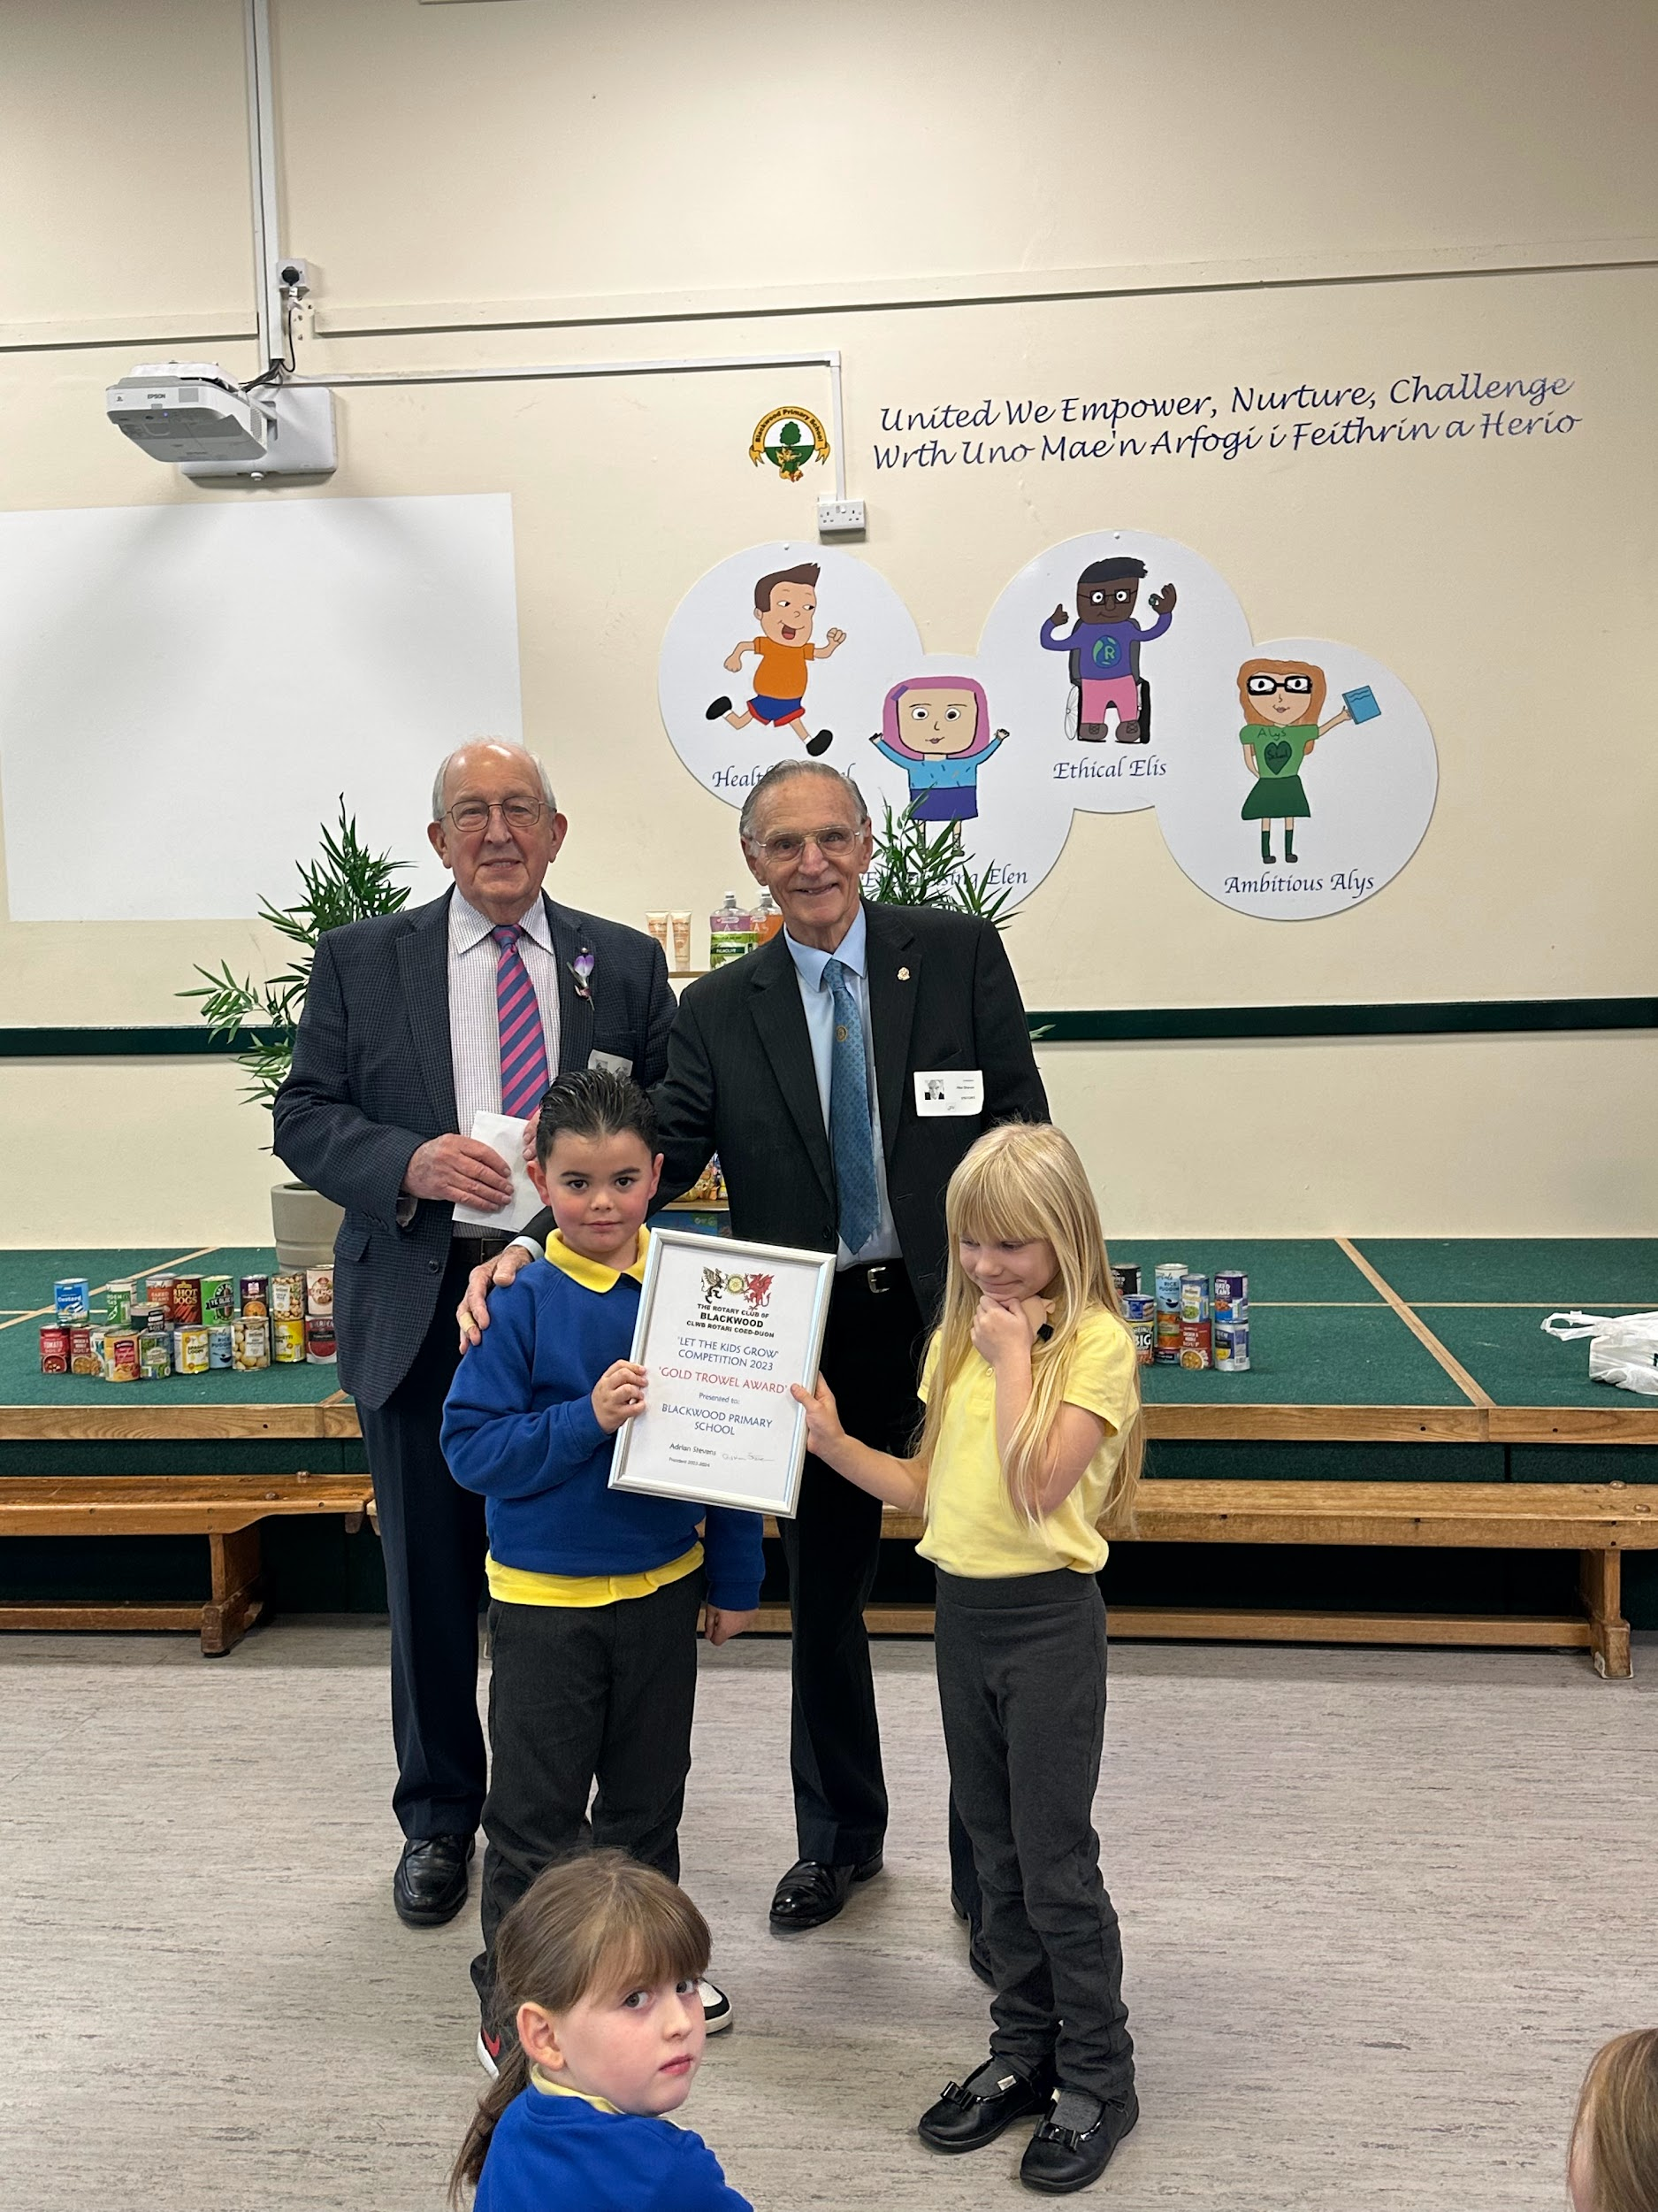
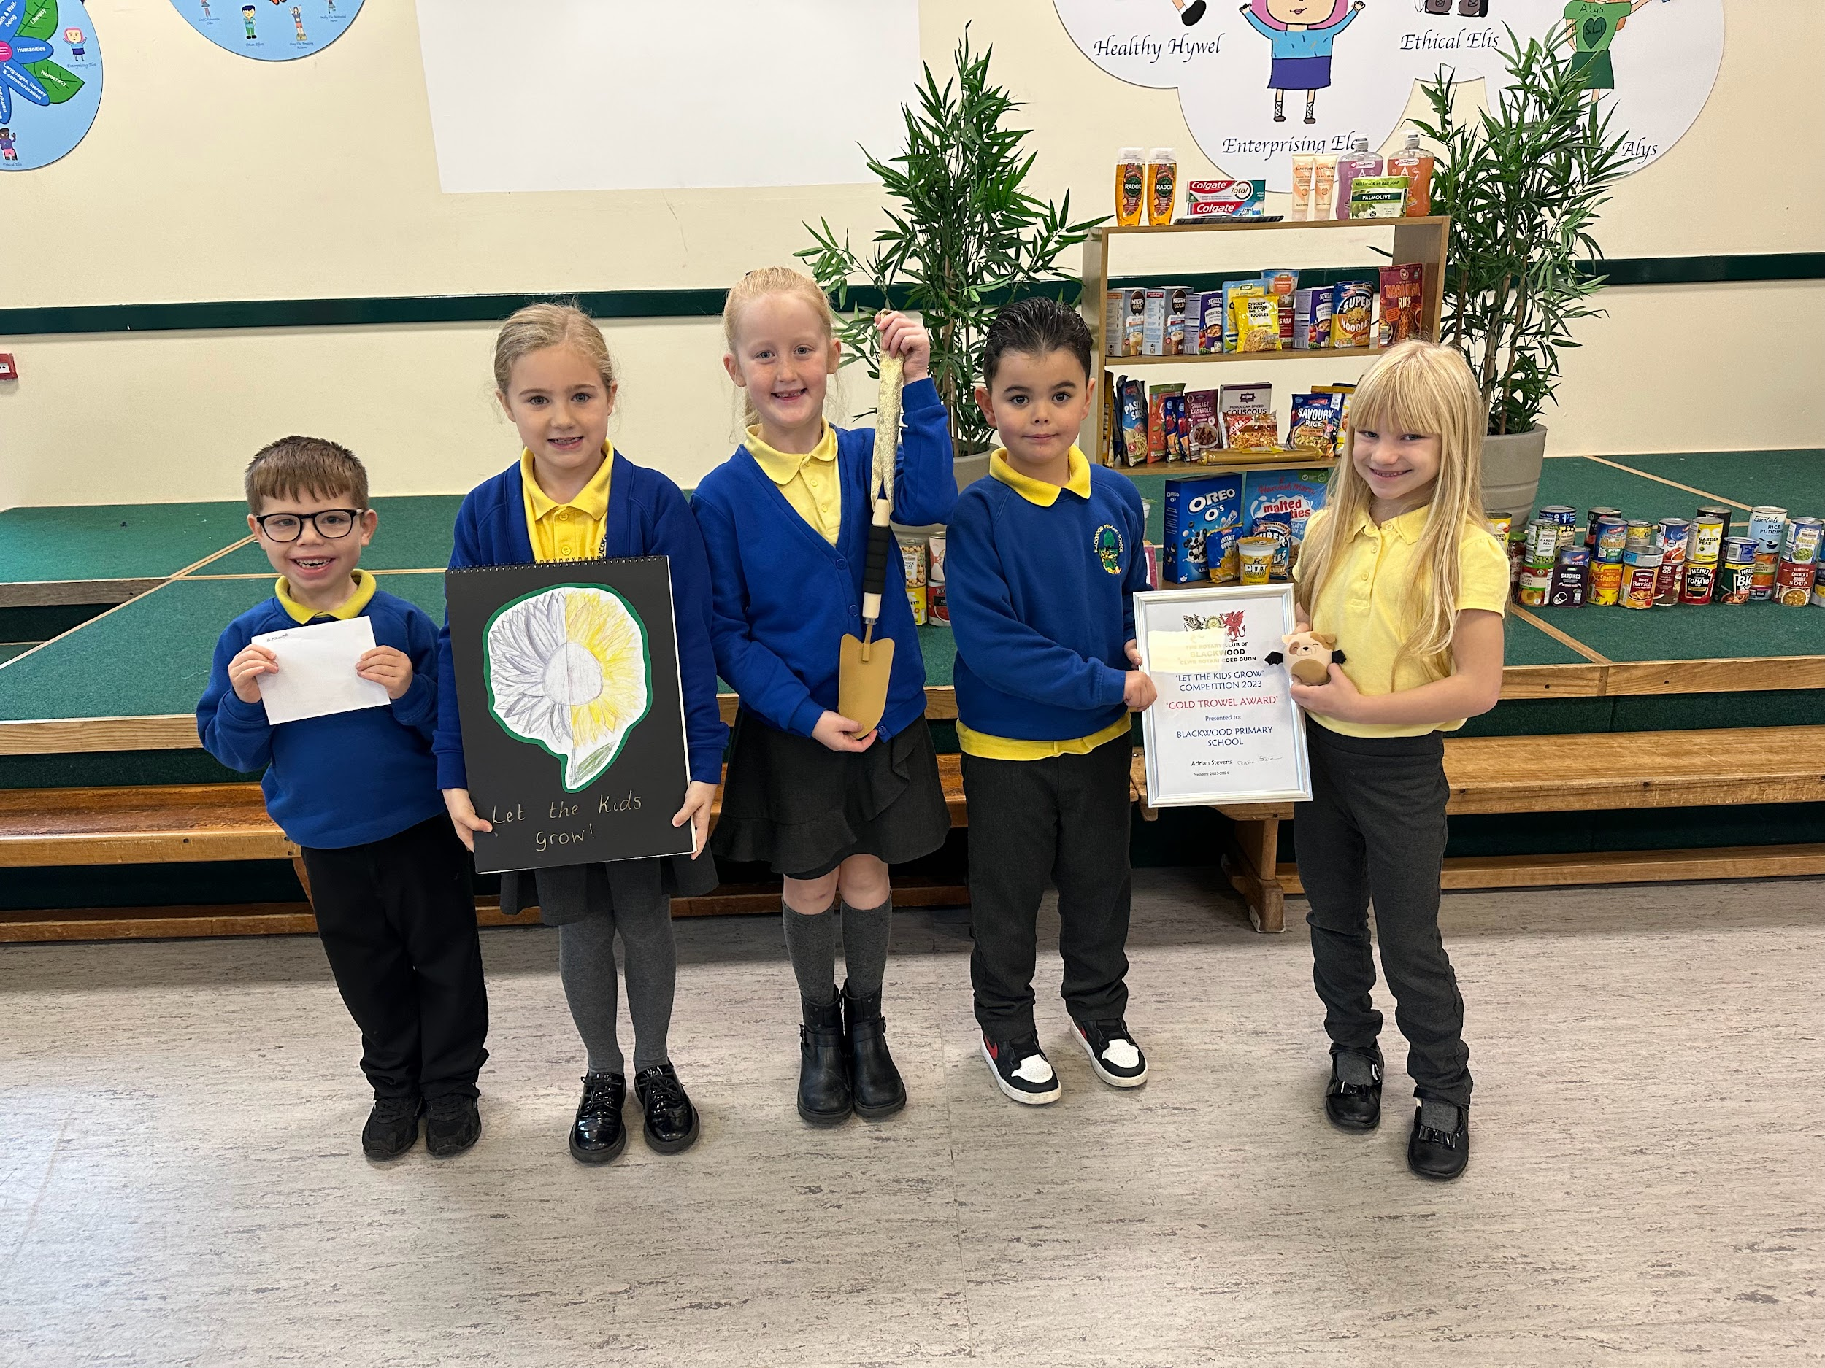
Action Days
Action Days and Awards
In Blackwood Primary School we make sure that we engage in as many action days as possible.
We also make sure that we engage with the local community to share our work and to set goals for developing our outdoor/natural areas.
In the summer, we took part in Earth Day. Everyone in the school wore something green and we raised over £100 for Size of Wales. This will help them continue their amazing work, striving to keep our world healthy for future generations.
Blackwood Rotary Club have worked very closely with us to set us challenges for our outdoor areas. We continue to hold the Golden Trowel for our amazing work in our allotment areas.
We have also worked closely with Asda, who have helped us massively by donating a variety of resources for us to use in our gardens.

Slide 12
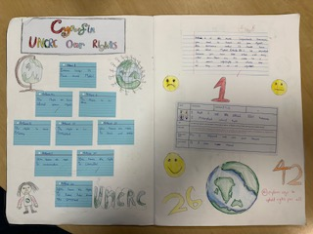
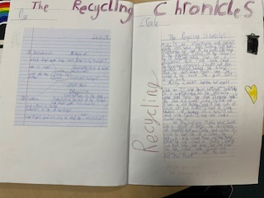
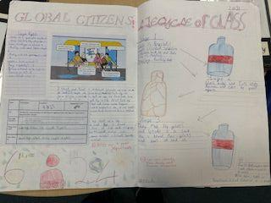
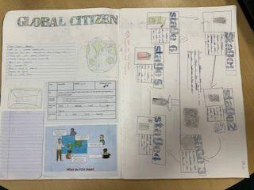
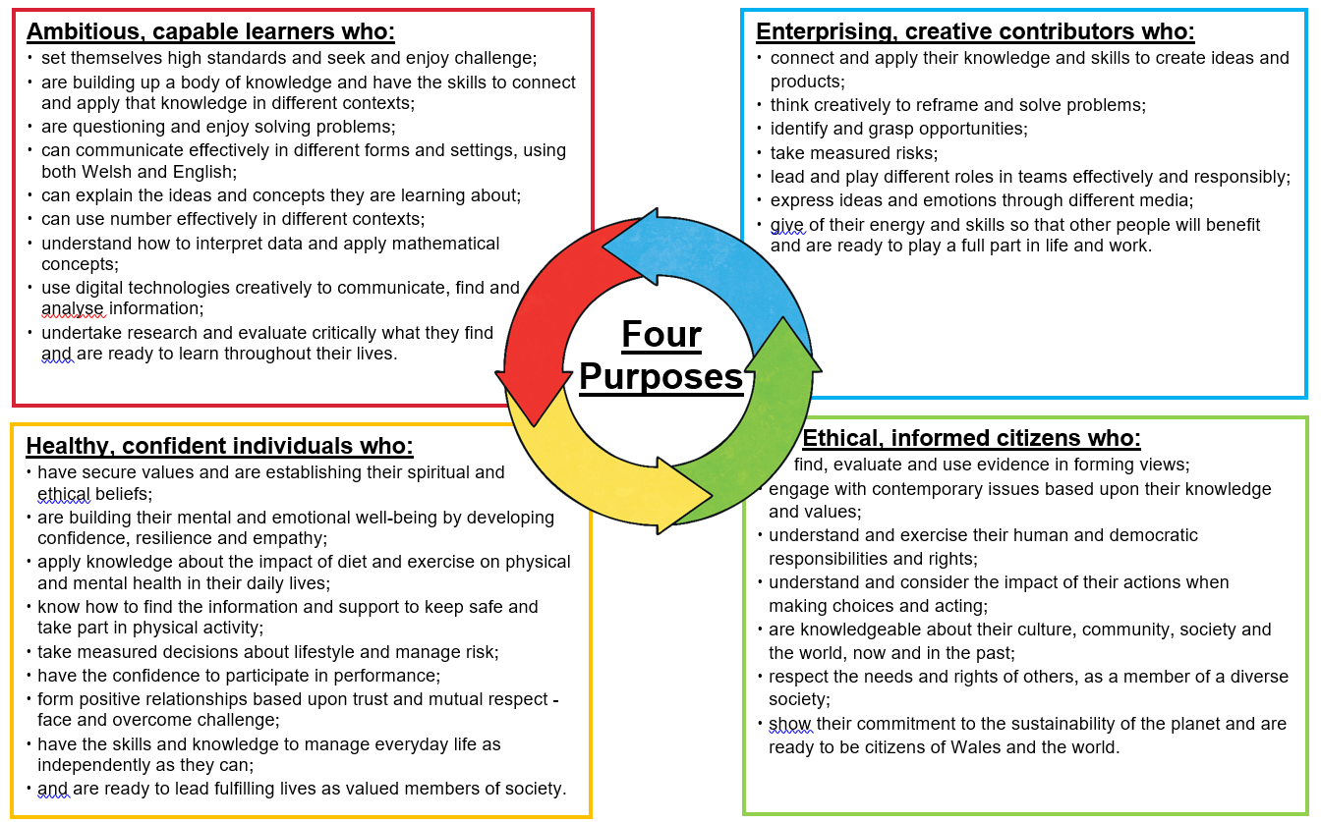
Eco Across the Curriculum
All things ECO
In Blackwood Primary School we make sure that we also promote Eco/sustainability as part of our learning journeys. This can either be as part of our INSPIRE work or through workshops organised by our class teachers.
On 22nd November 2024, Dwr Cymru will be visiting us. They will present an assembly to the whole school and then provide workshops for Year 3/4 throughout the rest of the day.
Here are some examples of work we have completed in class…!

Slide 13
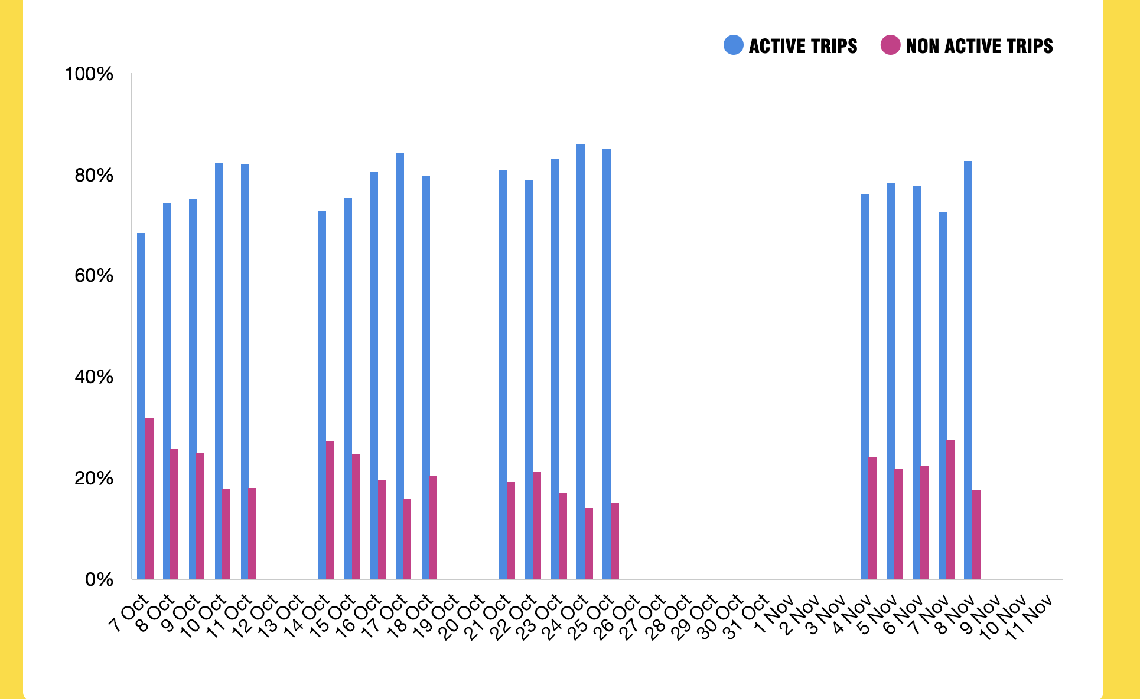

WOW Travel Tracker
Travel Tracker
As a whole school, we have been fortunate enough to be chosen to take part in the WOW Walk to School Challenge.
This challenge promotes active travel to school. We have been a part of this scheme since the last academic year (Summer Term) when this was relaunched.
By actively travelling to school (walk/wheel, cycle, scooter etc.), we can earn badges to show our commitment to choosing a more sustainable method of transport.

Slide 14
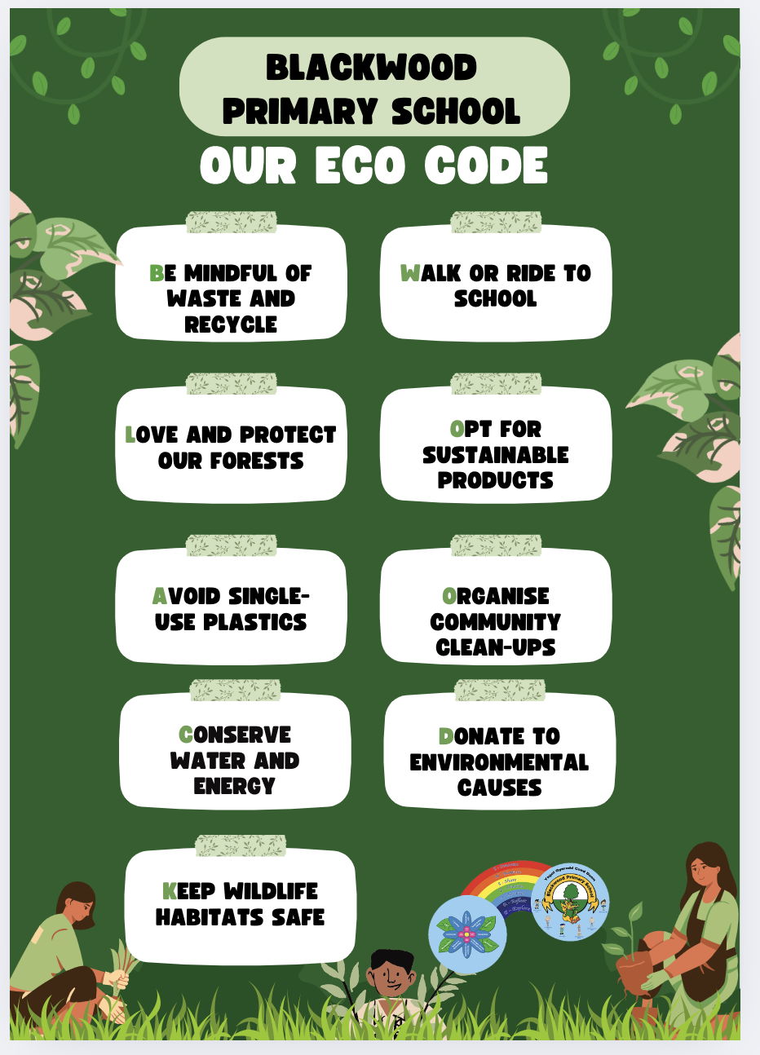
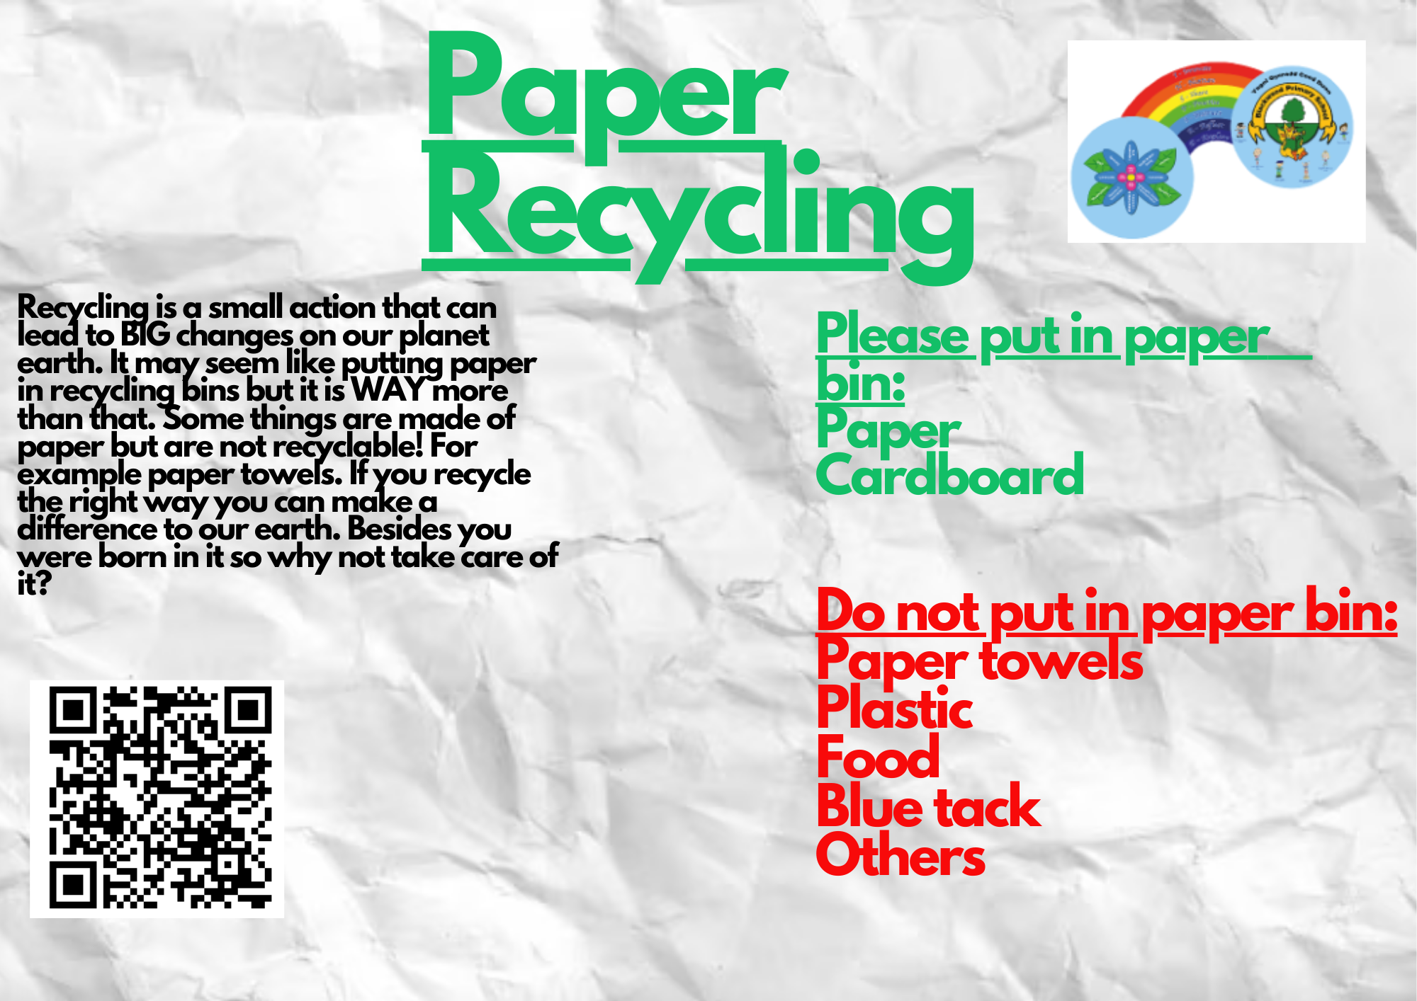

Our Eco Code
Our Eco Code
The members of the Eco Committee 2023-2024 came up with an Eco Code for us all to follow.
We have displayed this Eco Code in each Year Group and in other areas of the school, so that it is accessible to all pupils, members of staff and visitors in Blackwood Primary School.
We will review our Eco Code during the end of each term to see if there are any changes that we would like to make, so that it is always up to date.
One of our Eco Committee members from last year also created a poster for the paper recycling bins as he wanted to make sure they are used correctly at all times.

Slide 15
Thank You!
Thank you
Thank you for listening to our presentation! We hope that you have enjoyed seeing all the wonderful things we have being doing as part of the Eco Committee in Blackwood Primary School.
We look forward to continuing our hard work and being able to share our future work with you and everyone else at Blackwood Primary School.
We hope we have done enough to earn the Green Flag so that we can display it proudly so everyone can see. We look forward to hearing your feedback!

