Slide 1
E-Safety Parental Engagement

Slide 2
Aim of the session
Introduction to E-safety?
The digital world
Top tips for staying safe online
Cyber bullying
Let’s check what we have learned
Competition time!

Slide 3
What is E-Safety? E-Safety means making sure that the ways which children and young people use the internet, mobile phones or social media to communicate are safe.

Slide 5
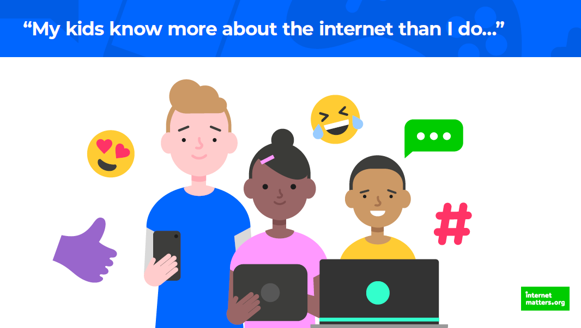

Slide 7
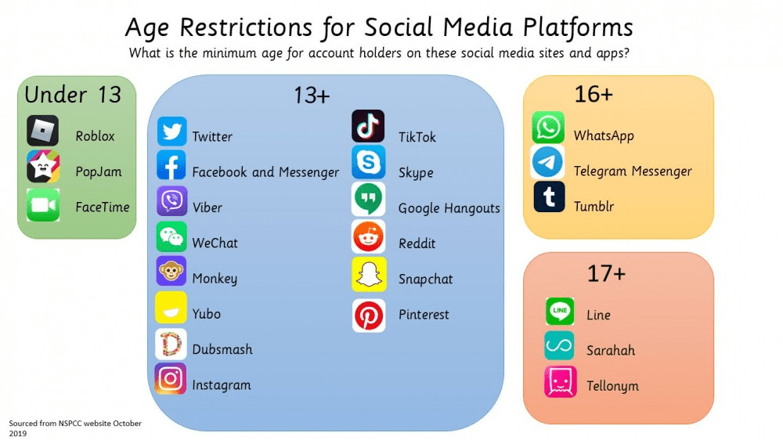

Slide 8
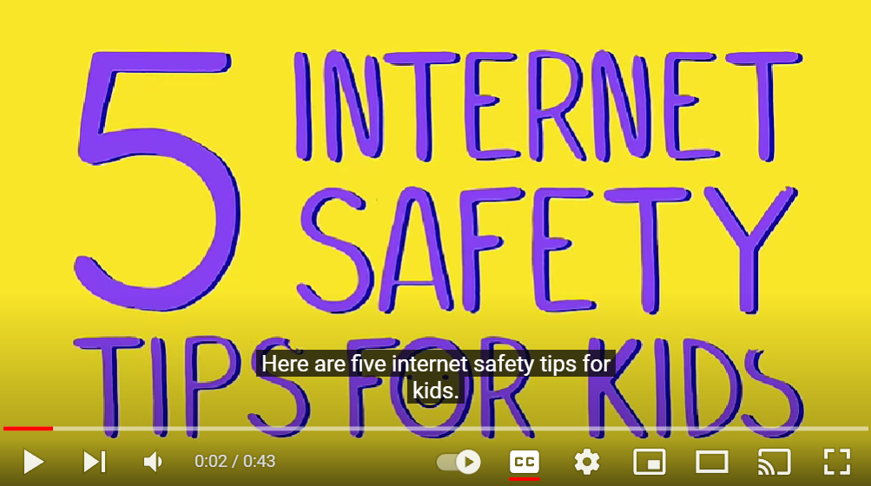

Slide 9
How can we stay safe online?

Slide 10
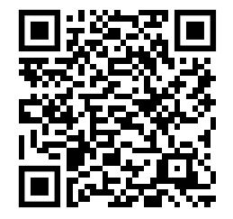

Slide 11
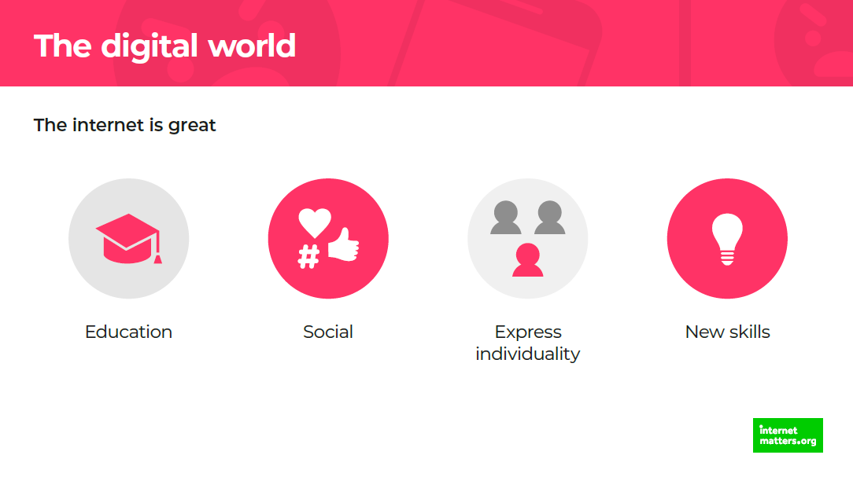

Slide 13
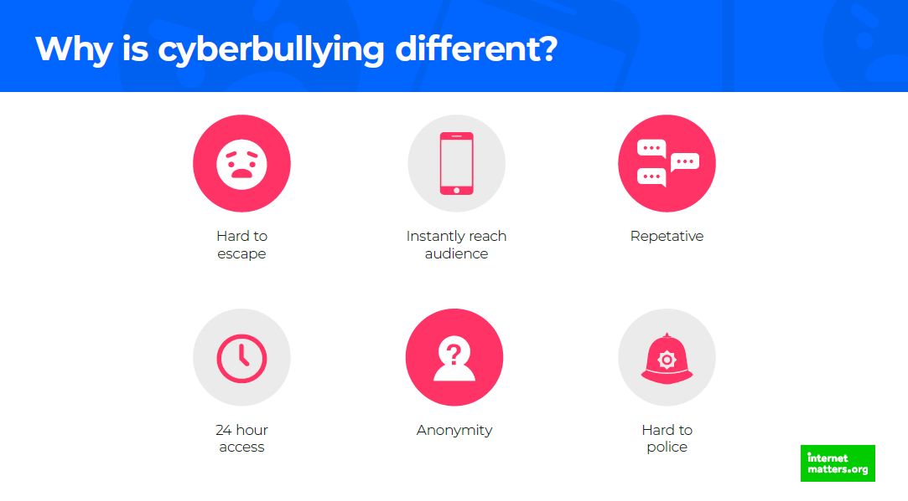

Slide 15
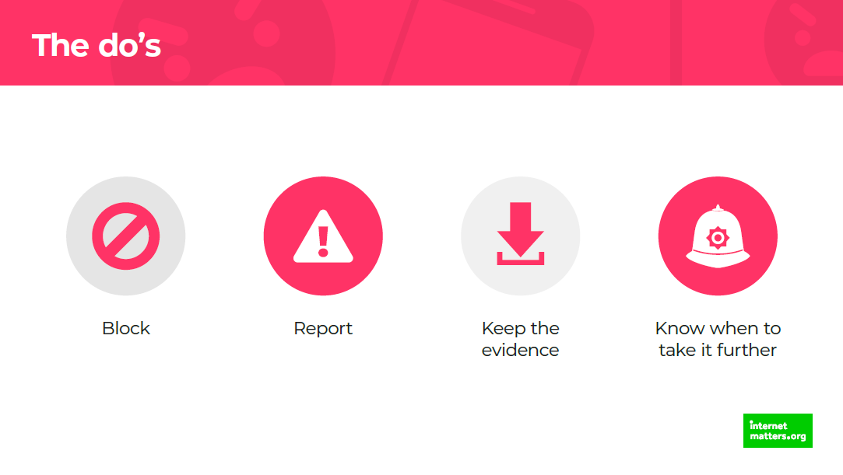

Slide 18
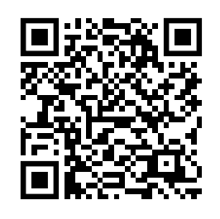

Slide 20
Challenge time!
Design a poster
Help people stay safe online
Or
Help people talk about and deal with cyberbullying

